Slide 1
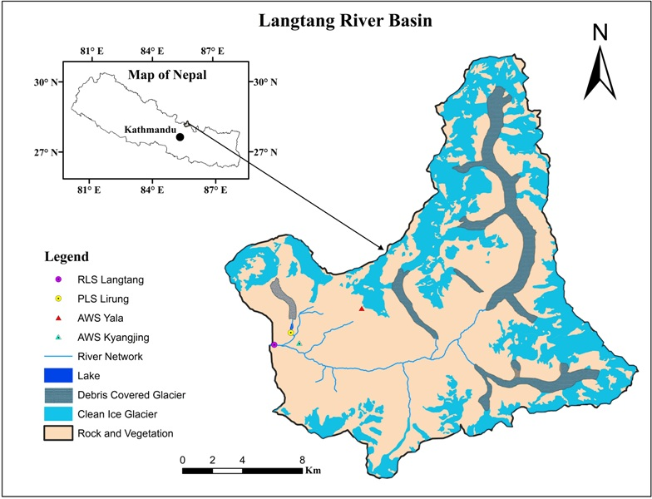
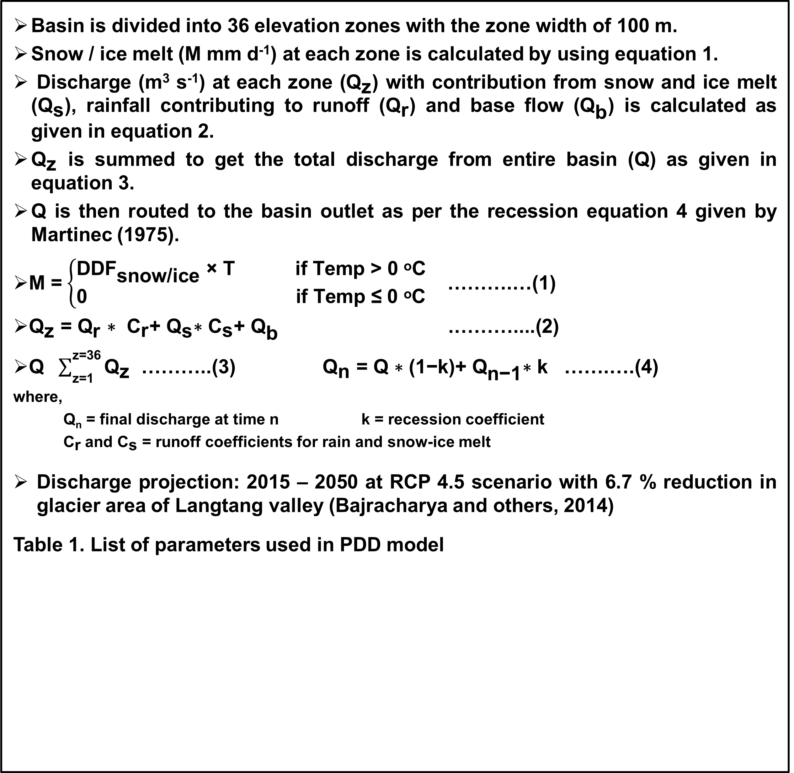
Abstract ID: ………………
Title of the Research Study
Name of the authors (First, middle and last name)
Name of the affiliated institution
E-mail address of the corresponding author
Introduction
Results
Positive degree day model is based on the relation that the melting of snow or ice during any particular period is proportional to the positive degree-day linked by the positive degree day factor.
It estimates snow and ice melt from the debris free areas as well as ice melt under debris layers with a minimum field data requirement (Kayastha and others, 2005).
Materials and Methods
Fig. 2. Comparison of observed and simulated discharges in calibration and validation period
To estimate daily discharge from the partly debris covered glacierized Langtang River basin of Nepal.
To predict future discharge with the relative contribution of snow and ice melt.
Study Area
  Located at Langtang Valley, Central Nepal
  Elevation range:
  3652 m a.s.l. - 7215 m a.s.l.
  Total area: 353.6 km²
  Glaciers (debris covered and clean ice): 137.5 km²
  Rock and vegetation:
  216.1 km²
Fig. 3. Projected annual temperature (a) and precipitation (b) for Langtang station (2015 - 2050)
Fig. 1. Location map of Langtang River Basin (Pradhananga and others, 2014)
Fig 4. Monthly partitioning of runoff components (2013)
Fig 5. Future discharge projection (2015 – 2050)
Methods
  Basin is divided into 36 elevation zones with the zone width of 100 m.
  Snow / ice melt (M mm d⁻¹) at each zone is calculated by using equation 1.
  Discharge (m³ s⁻¹) at each zone (${\text{Q}}_{\text{z}}$) with contribution from snow and ice melt (${\text{Q}}_{\text{s}}$), rainfall contributing to runoff (${\text{Q}}_{\text{r}}$) and base flow (${\text{Q}}_{\text{b}}$) is calculated as given in equation 2.
  ${\text{Q}}_{\text{z}}$ is summed to get the total discharge from entire basin (Q) as given in equation 3.
  Q is then routed to the basin outlet as per the recession equation 4 given by Martinec (1975).
  M =$\left\{\begin{aligned}{\text{DDF}}_{\text{snow}\text{/}\text{ice}} \text{×} \text{T} \text{if} \text{T}\text{emp} \text{>} \text{0} \text{ᵒ}\text{C} \\ \text{0 }\text{if} \text{T}\text{emp} \text{≤} \text{0} \text{ᵒ}\text{C}\end{aligned}\right.$ ……….…(1)
  ${\text{Q}}_{\text{z}}\text{ = }{\text{Q}}_{\text{r}}\text{ ∗ }{\text{C}}_{\text{r}}\text{+ }{\text{Q}}_{\text{s}}\text{∗}{ \text{C}}_{\text{s}}\text{+ }{\text{Q}}_{\text{b}}$ .………....(2)
  $\text{Q} \sum_{\text{z}\text{=1}}^{\text{z}\text{=36}}{{\text{Q}}_{\text{z}}}$ ………..(3) ${\text{Q}}_{\text{n}} \text{=} \text{Q}\text{ ∗ (1−}\text{k}\text{)+ }{\text{Q}}_{\text{n}\text{−1}}\text{∗ }\text{k}$ …….….(4)
where,
Q_{n} = final discharge at time n k = recession coefficient
${\text{C}}_{\text{r}}$and ${\text{C}}_{\text{s}}$ = runoff coefficients for rain and snow-ice melt
Discharge projection: 2015 – 2050 at RCP 4.5 scenario with 6.7 % reduction in glacier area of Langtang valley (Bajracharya and others, 2014)
Table 1. List of parameters used in PDD model
Fig 6. Contribution of snow – ice melt and rain – base flow in monthly discharge in years 2020 and 2050
Conclusions
Annual mean discharge for the calibration and validation periods are 9.13 m³ s⁻¹ and 8.50 m³ s⁻¹, respectively.
Snow and ice melt contributing to the discharge of river in 2013 is 41.3 %.
Projected discharge of the basin (2015 – 2050) shows increase in river discharge by 0.013 m³ s⁻¹ year⁻¹ with the decrease in snow-ice melt contribution resulting to 34.8 % in 2050.
This model gives insights into the hydrological system dynamics of the glacerized basin with the contribution of snow and ice melt in discharge and also estimates the water availability of the Himalayan region.
Change in Debris Parameters | Change in Melt_{day}
+10 % K_{d} (Thermal Conductivity) | -8 .76 to + 10.98 %
+10 % C_{d} (Volumetric Heat Capacity) | 0 %
+10 % z_{0m} (Surface roughness length for momentum) | 0 %
+2 % ε_{d} ( Emissivity) | -0.60 to + 4.58 %
Periods | Modelled melt rate (mm w.e. d⁻¹)
Pre-monsoon | 1.9
Monsoon | 5.5
Post-monsoon | 1.5
Periods | Modelled melt rate (mm w.e. d⁻¹)
Pre-monsoon | 1.9
Monsoon | 5.5
Post-monsoon | 1.5
Periods | Modelled melt rate (mm w.e. d⁻¹)
Pre-monsoon | 1.9
Monsoon | 5.5
Post-monsoon | 1.5
Periods | Modelled melt rate (mm w.e. d⁻¹)
Pre-monsoon | 1.9
Monsoon | 5.5
Post-monsoon | 1.5
Parameter | Description | Value
DDF | Degree day factor | 6.0 – 10.5 mm d^{-1 o}C⁻¹ (Snow) 6.5 – 9.5 mm d^{-1 o}C⁻¹ (Ice)
DDF_{debris} / DDF_{ice} | Ratio of DDFs for debris covered ice to bare ice | 0.5 – 0.58
C_{r} and C_{s} | Runoff coefficients for rain and snow-ice melt | 0.4 – 0.65
Q_{b} | Base flow | 1.1 – 2.2 m³ s⁻¹
References
Bajracharya SR, Maharjan SB, Shrestha F, Bajracharya OR and Baidya S (2014) Glacier status in Nepal and decadal change from 1980 to 2010 based on Landsat data. International Centre for Integrated Mountain Development (ICIMOD), Kathmandu.
Kayastha RB, Ageta Y and Fujita K (2005) Use of positive degree-day methods for calculating snow and ice melting and discharge in glacierized basins in the Langtang Valley, Central Nepal. In De Jong C, Collins D and Ranzi R (Ed.) Climate and Hydrology in Mountain Areas, Chichester, UK; John Wiley, 7-14.
Martinec J (1975) Snowmelt-runoff model for stream flow forecasts. Nordic Hydrology, 6(3), 145-154 (doi:10.2166/nh.1975.010).
Pradhananga NS, Kayastha RB, Bhattarai BC, Adhikari TR, Pradhan SC, Devkota LP, Shrestha AB and Mool, PK (2014) Estimation of discharge from Langtang River basin, Rasuwa, Nepal, using a glacio-hydrological model, Annals of Glaciology, 55(66), 223-230 (doi: 10.3189/2014AoG66A123).
Acknowledgements: The authors are thankful to the Partnership for Enhanced Engagement in Research (PEER) Science Project funded by the United States Agency for International Development (USAID) through the National Science Foundation (NSF), USA for supporting this research, Department of Hydrology and Meteorology, GoN; the Himalayan Climate Change Adaption Program (HICAP) implemented jointly by ICIMOD and other agencies for providing climate data and the Department of National Park and Wild Life Conservation.

